Slide 1

Ebusiness. Local. Redefined.
August 2016

Slide 2
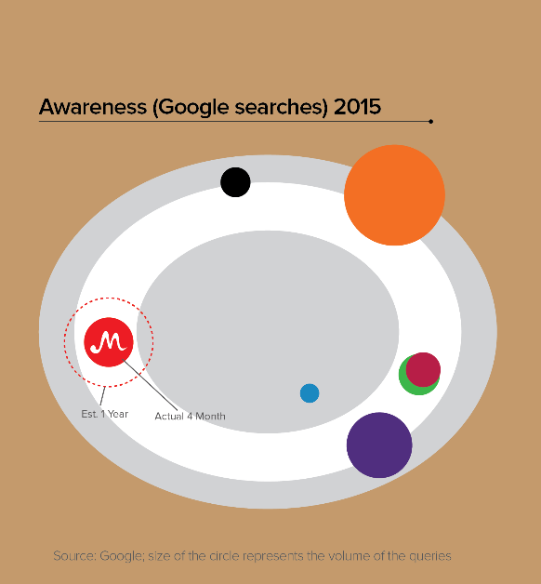
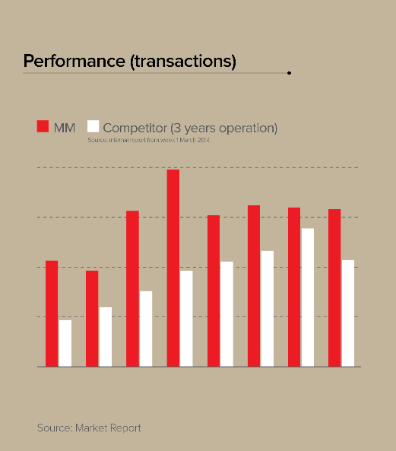
Less than a year old, we had a great start.

Slide 3







Powered by Lippo with a network of strong “Consumer Services” oriented companies
140
Stores
#1 Department Store
62
Malls
111
Stores
#1 Listed Property Developer
#1 Shopping Mall
#1 Hypermarket
>15,000
Hectares landbank
O2O
140
Stores
#1 Department Store
22
Hospitals
#1 Hospital Operator
39
Stores
111
Stores
#2 English Language Bookstore
#1 Hypermarket
Merchandizing
64
Screens
#3 Largest Cinema Chain
>400,000
Subscribers
#2 DTH⁽¹⁾ Provider
1.5mm
Homes passed
>1.4mm
Subscribers
#1 Broadband Operator
#1 4G LTE Service
Provider
Marketing

Slide 4

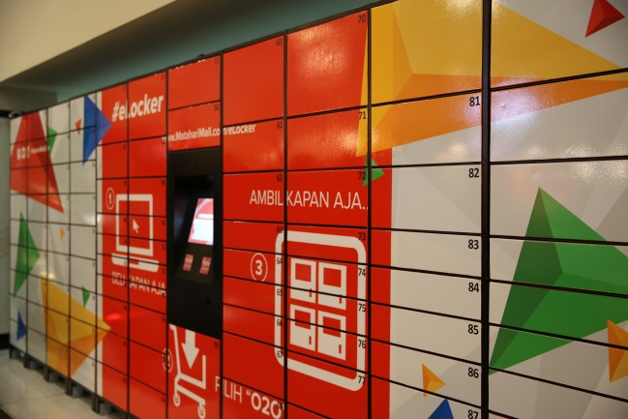
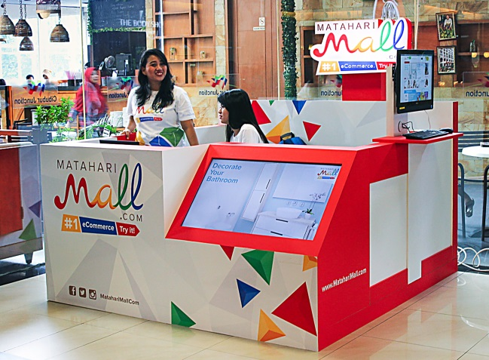
Localized Offerings: Hundreds of O2O points to serve the underserved
50+
600+
Metro Cities: Self Pickup at eLockers
Provides extra convenience for urban customers
50+ eLockers currently available at public locations such as shopping malls, apartments, universities, train stations, and post offices
Unmanned operations
Non-Metro Cities: Pickup & Payment Points
600+ pickup & payment points in 90 cities and 400 districts
Located in public areas such as shopping malls and post offices
(Wo)manned operations

Slide 5
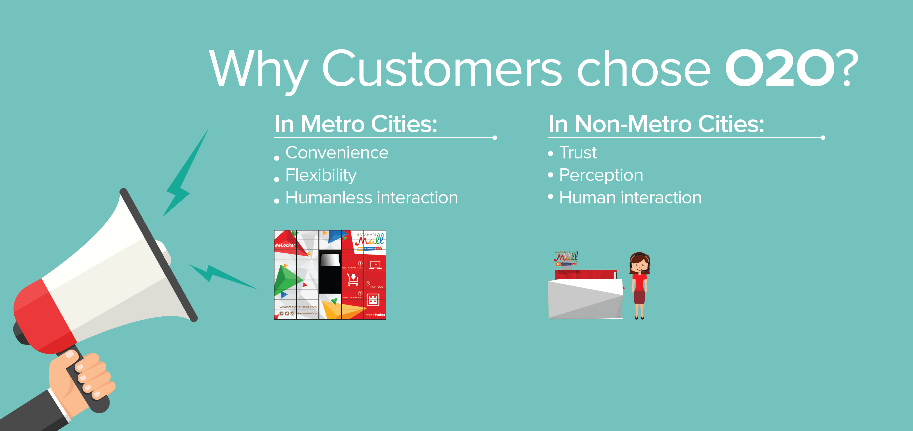
Localized Offerings: Hundreds of O2O points to serve the underserved
Norviana
Jl.Objek Wisata Lemo
Kab.Toraja, SULAWESI SELATAN, 91817

Slide 6
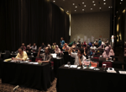
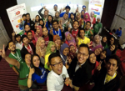
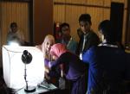
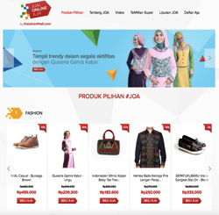




Localized empowerment program: #JualOnlineAja targeting SMEs with “production” capacity
SEMINAR & WORKSHOP “GO ONLINE FOR BETTER UKM”
I. EDUCATION
II. INCUBATION
III. PROMOTION
SPECIAL LANDING PAGE
FOR UMKM & SOCIAL MEDIA PROMOTION
TEMMAN SUPER PROGRAM
COMPETITION & ACTIVE SELLER SERVICE

Slide 7
First Lebaran performance:
Top 10 biggest impacted cities have orders and values increase 1241% and 425%
425%
1241%
1. Batu
2. Tanjung Balai
3. Serang
4. Binjai
5. Bitung
6. Ternate
7. Banjar
8. Pekanbaru
9. Sorong
10. Padang Sidempuan
1. Magelang
2. Cimahi
3. Banjar
4. Palopo
5. Sorong
6. Tasikmalaya
7. Tomohon
8. Bitung
9. Blitar
10. Ambon
7
Notes:
Speaker: Pak Wenas
Key notes:
Brand is critical to trust and our success – directly related to merchant and customer trust which is pivotal in nascent e-commerce market
Matahari
#1 retail brand in Indonesia
100s of millions of dollars invested
Completely bypasses the education and marketing phases of brand development
No other eCommerce company in top 50
The brand is helping us expand the total addressable market and reach it more quickly with less marketing spend – merchants and consumers are using us who would not use an other e-commerce company

Slide 8
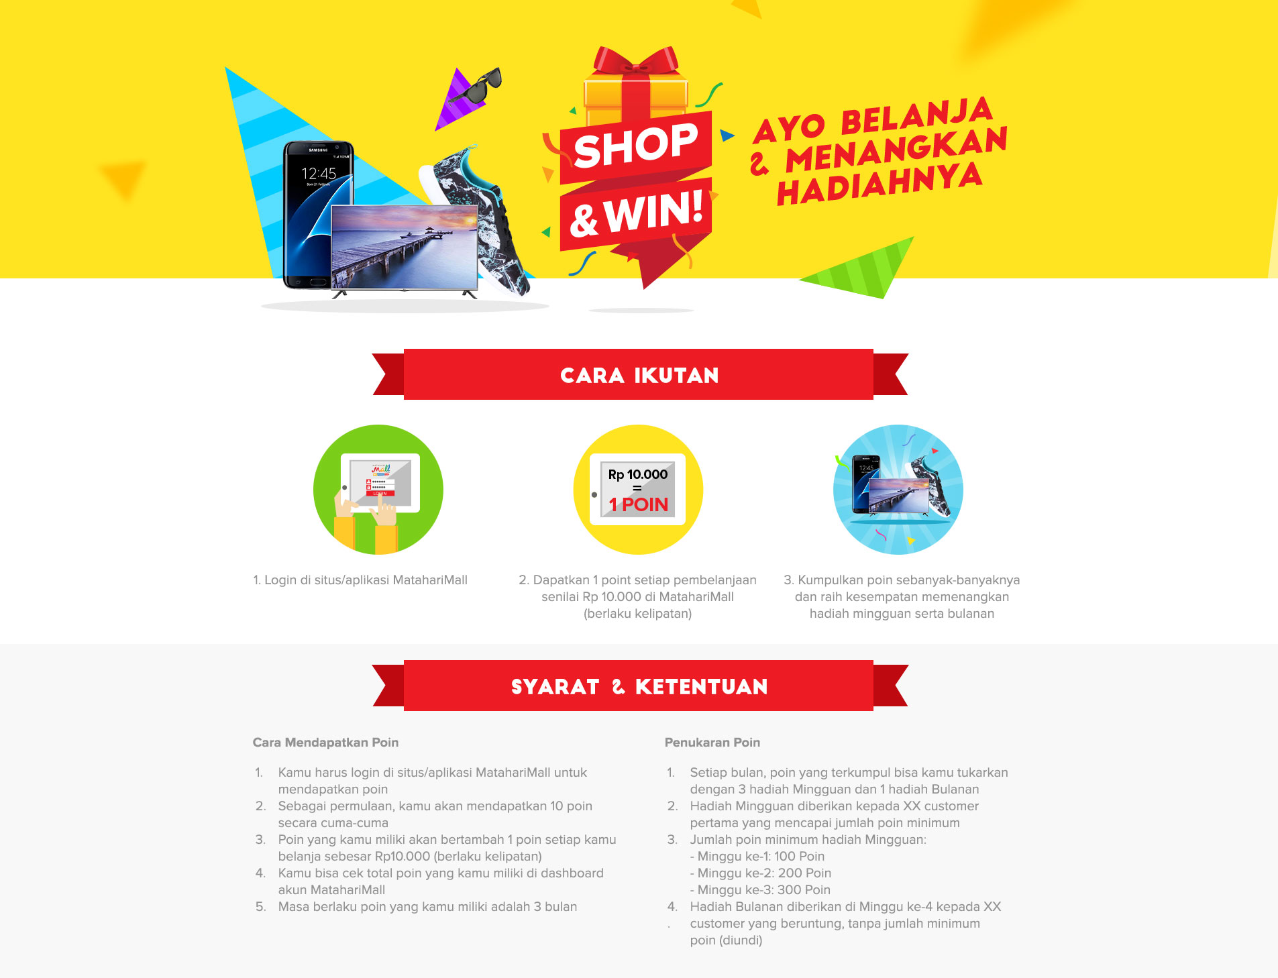
Shop & Win! program:
Belanja makin banyak dapat poin makin banyak, menang hadiah makin banyak
8
Notes:
Speaker: Pak Wenas
Key notes:
Brand is critical to trust and our success – directly related to merchant and customer trust which is pivotal in nascent e-commerce market
Matahari
#1 retail brand in Indonesia
100s of millions of dollars invested
Completely bypasses the education and marketing phases of brand development
No other eCommerce company in top 50
The brand is helping us expand the total addressable market and reach it more quickly with less marketing spend – merchants and consumers are using us who would not use an other e-commerce company

Slide 9


Enjoy 100.000 discount only for First 20 Shoppers
Voucher Code: MMINDONESIAX
Min purchase 400.000, Exclude: Electronics, Smartphone & Tablet, Pulsa Vouchers, Groceries, and Gold
Vouchers expired on 31 Aug 2016
@toing2
toing2

